Slide 1
Best OPI, Yet (BOY)
Xihui Chen, Kay Kasemir
chenx1@ornl.gov
April, 2013
IHEP

Slide 2
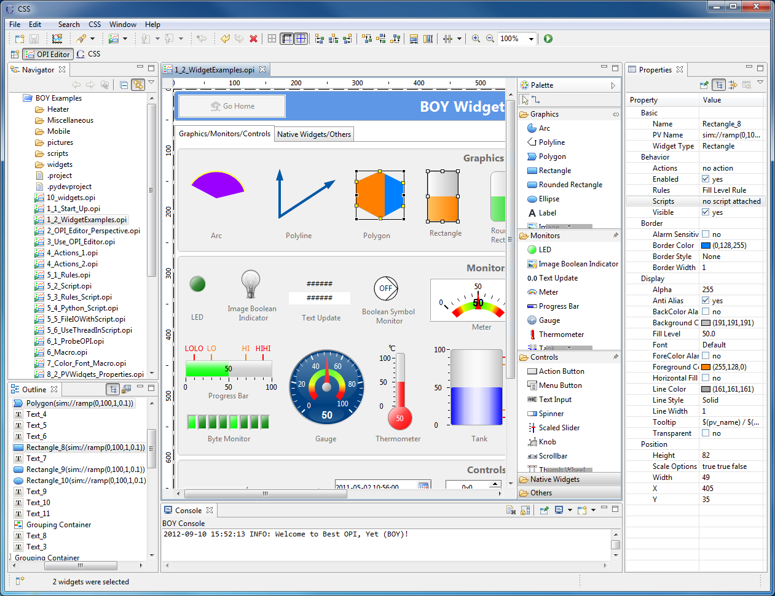
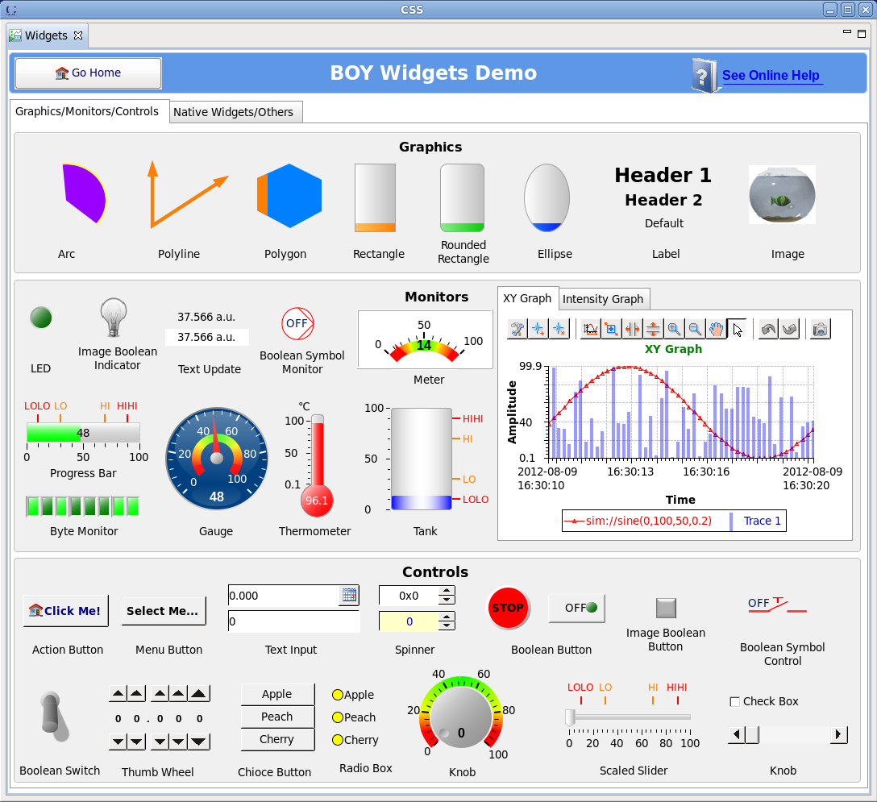
What is BOY?
BOY (Best OPI, Yet) – An Operator Interface (OPI) development and runtime environment
OPI is the Graphical User Interface for control systems
OPI Editor
Runtime

Slide 3

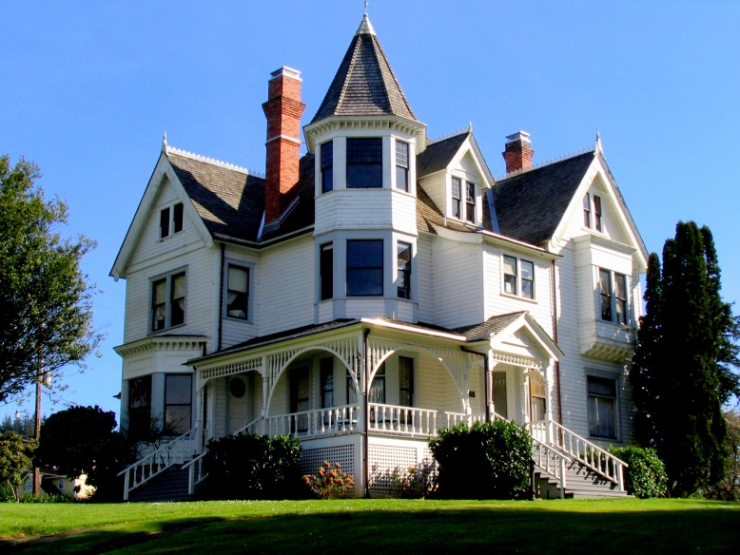
Relationship between CSS and BOY
CSS
Infrastructure for hosting control system tools (the house)
RCP product
BOY
One of the tools integrated in CSS (furniture in the house)
Plugins
Data
Browser
CSS
Probe
PyDev
BOY

Slide 4
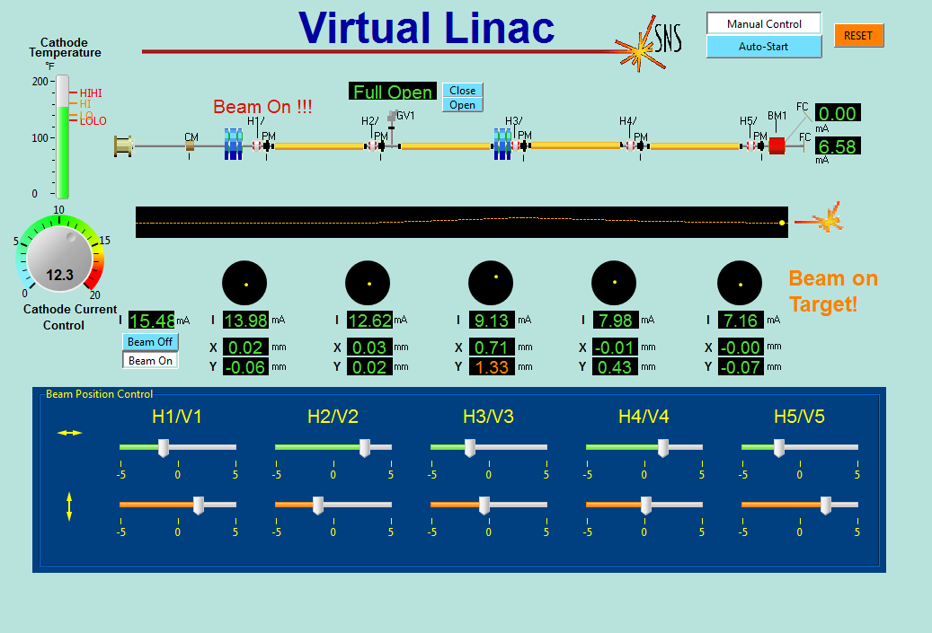
Examples-Virtual Linac

Slide 5
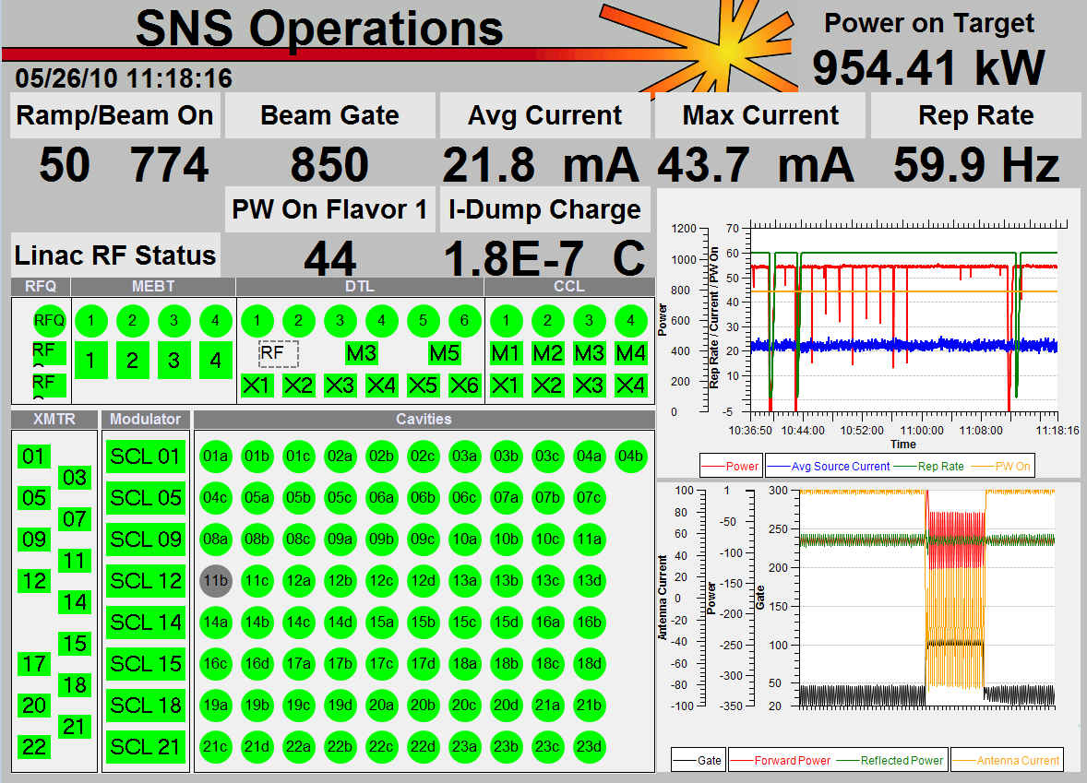
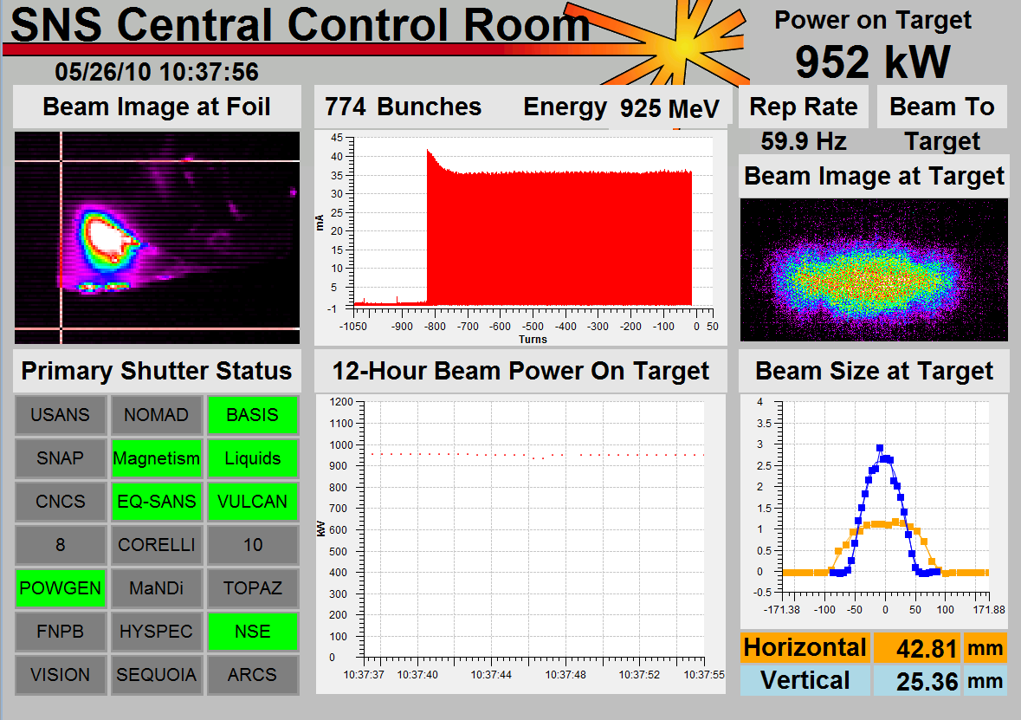
Examples-SNS
SNS top-level displays created by operators
Tim Southern, Nick Luciano

Slide 6
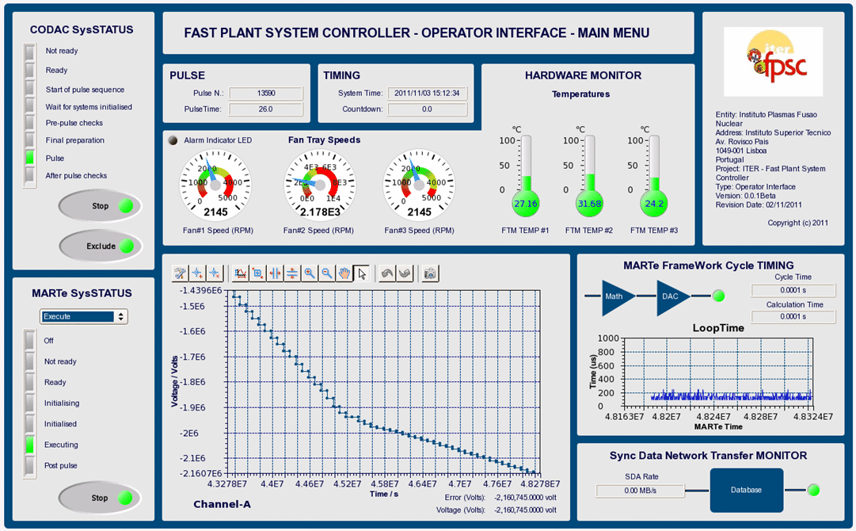
Examples-ITER

Slide 7
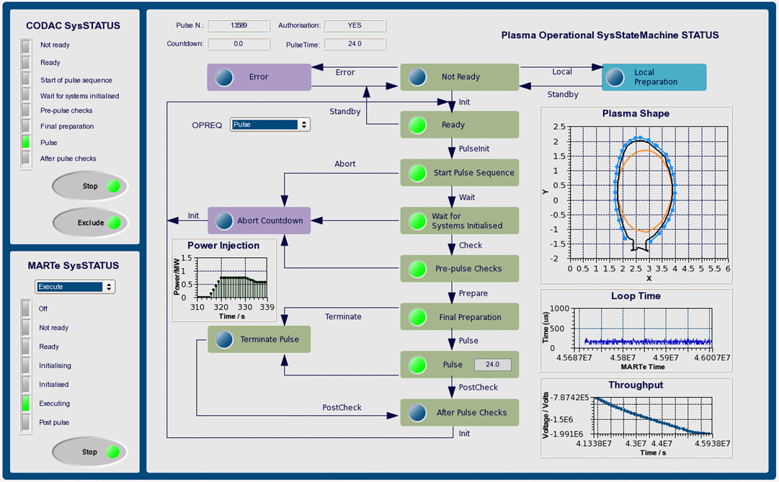
BOY OPI Examples-ITER

Slide 8
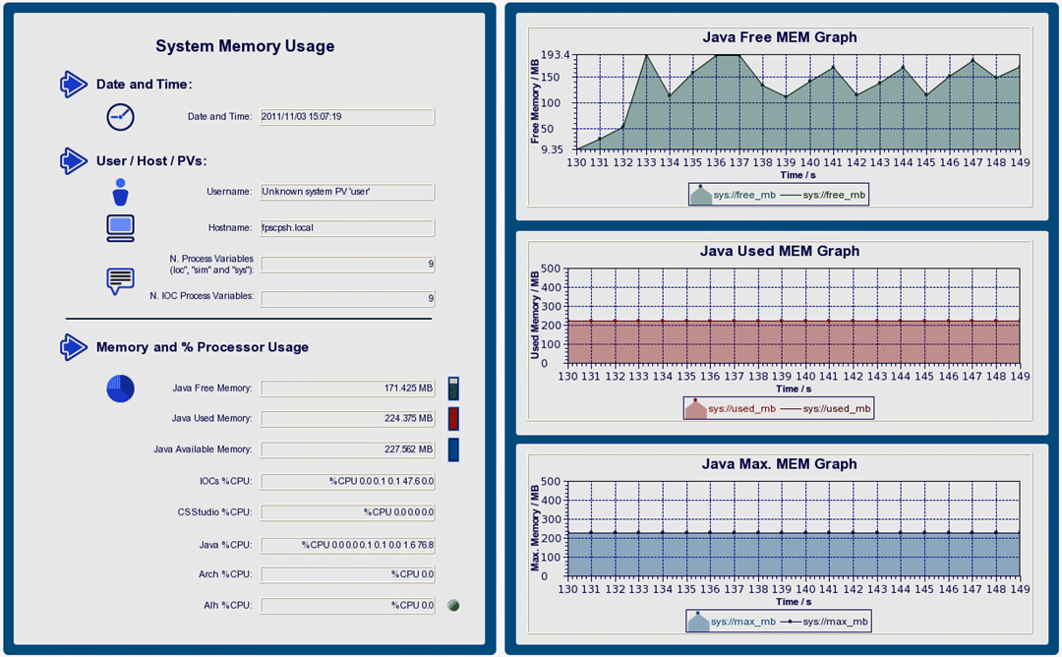
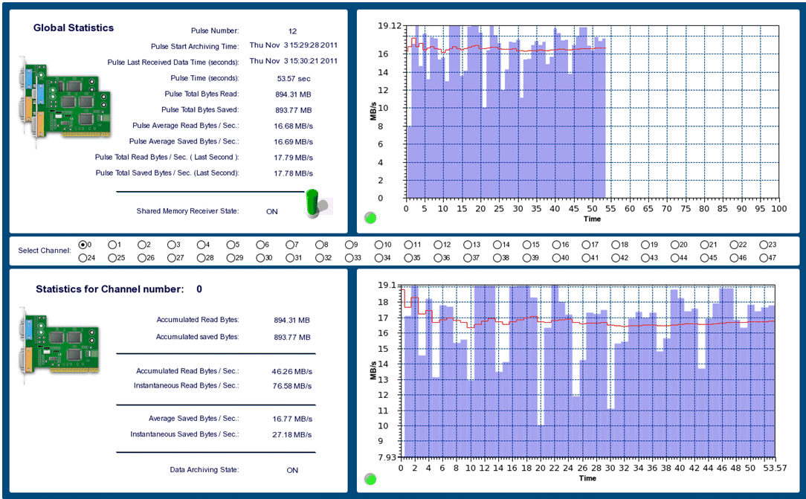
BOY OPI Examples-ITER

Slide 9
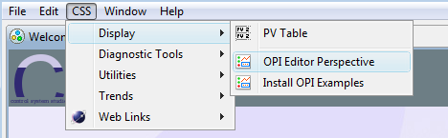
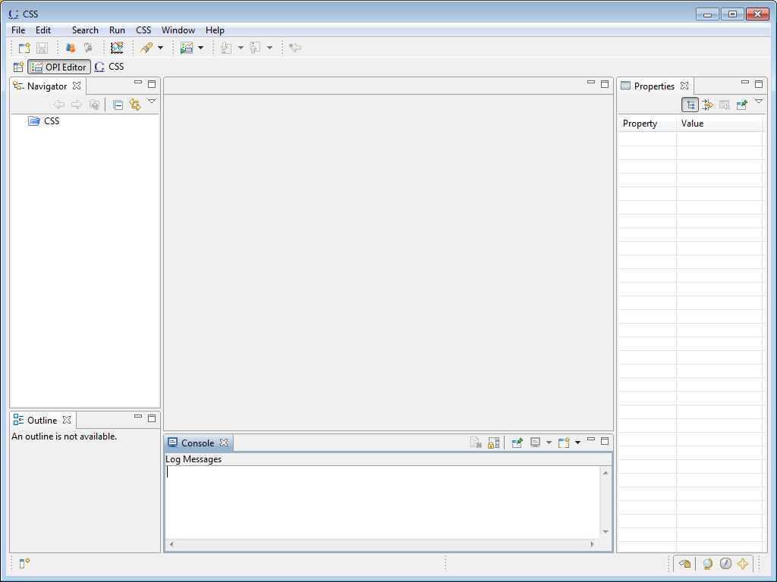
Let’s Start!
Open OPI Editor Perspective:
Menu CSS, Display, OPI Editor Perspective

Slide 10
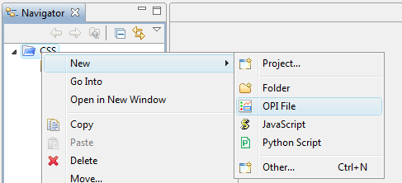
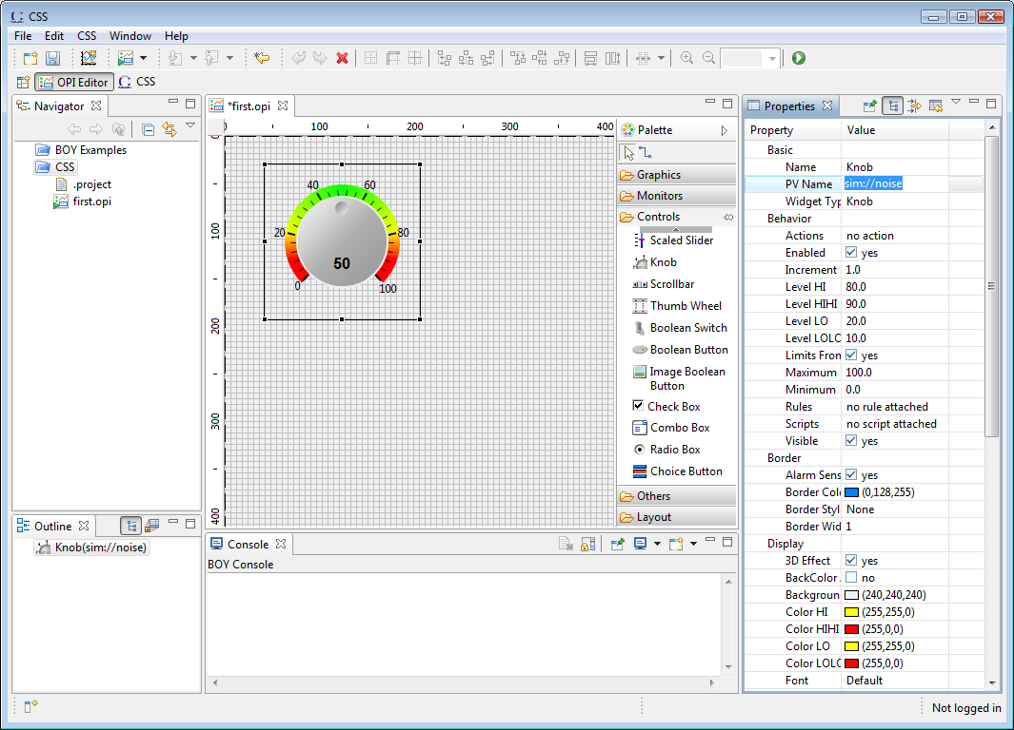
Exercise: Edit First OPI
Right click CSS Project in navigator: New, OPI File, call it “first.opi”
Or Menu File, New, BOY, OPI File
Drag widget Knob from palette to editor
Input sim://noise as the PV name in Properties view
Click the “Run” button (or Ctrl+G) to execute!
sim://noise is a simulated PV inside CSS (See CSS help->CSS Core->Process Variables), so you don’t need to run an IOC to try this example. In reality, you can replace it with a real EPICS PV

Slide 11
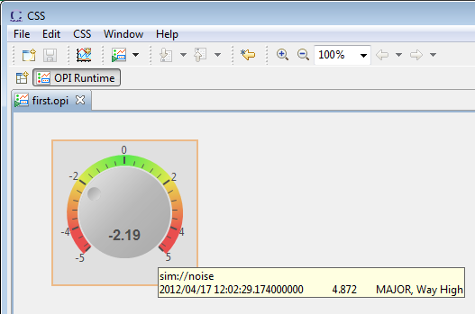

Exercise: Run First OPI
What you will get
PV value as text and via knob position
PV severity reflected in border color
PV name and value shown in tool-tip
PV’s display limits set the knob’s default range
Indicate ‘disconnected’ state via a pink border
Widget will be grayed-out if read-only
Main Point: Simple Things are Simple

Slide 12
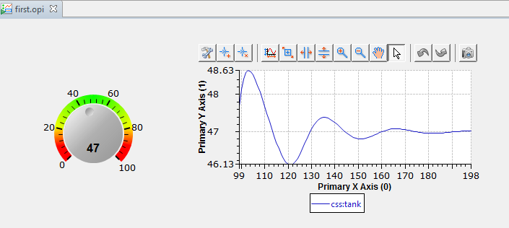
Exercise: Extend First OPI to Use EPICS PV
Set Knob’s PV Name property to css:setpoint
Add an XY Graph widget
Set PV Name to css:tank
Run

Slide 13
OPI Editor Perspective
Your All-in-One workbench for OPI editing
Toolbar
Navigator
Editor
Palette
Properties
Outline
Console

Slide 14
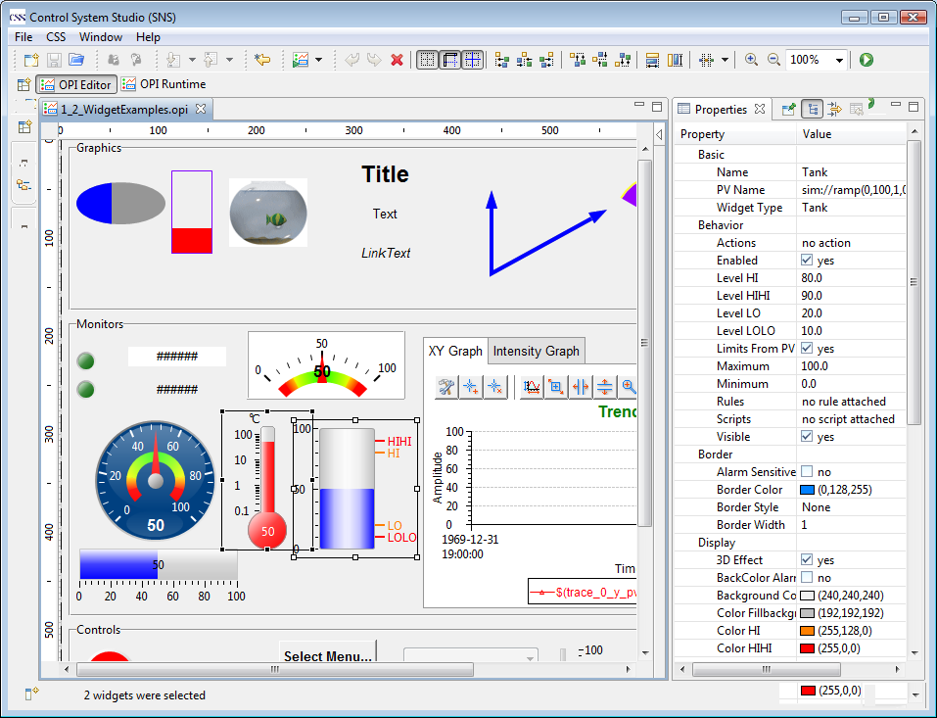
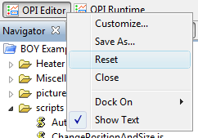
Demo: Customize OPI Editor Perspective
Every part in the workbench can be dragged around, detached, minimized, maximized or closed.
Recover the default perspective by resetting it.
A Customized Perspective

Slide 15
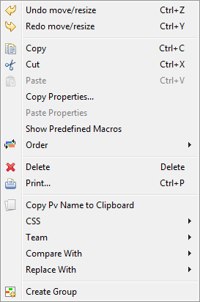
OPI Editor
What You See Is What You Get (WYSIWYG)
Comprehensive editing functions on toolbar and context menu
Copy/Paste/Delete
Drag & Drop
Undo/Redo
Alignment & Distributing
Snap to G (Grid/Geometry/Guide)
Zoom In/Out
Copy/Paste Properties
Changing Orders
…
As easy as editing PowerPoint

Slide 16
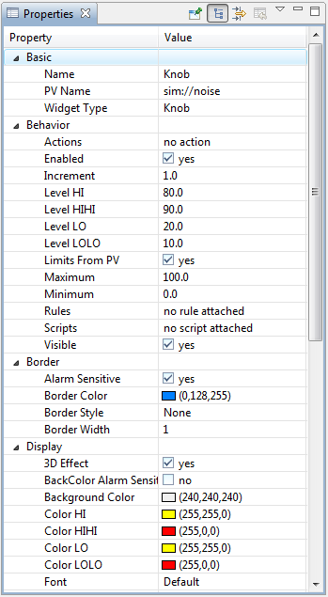
Properties View
Widgets are configured by setting Properties in the Properties view
Common Properties:
Name
Background/Foreground color
Border
Font
Position
Widgets that read/write PVs:
Basic: PV Name
Border: Alarm Sensitive
Behavior: Limits from PV
Display: Background/Foreground color alarm sensitive

Slide 17
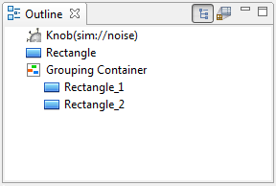
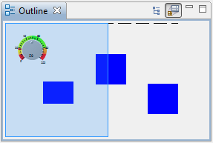
Outline
Click here to switch to overview outline
Tree View Outline
Click on widgets on the tree will select widgets in editor
Change widgets order by drag & drop
Overview Outline
An overview of the whole OPI
Click here to switch to tree view outline

Slide 18
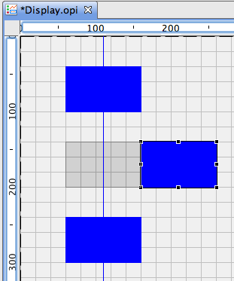
Exercise: OPI Editing Skills
Create a new OPI editor.opi
Add three rectangle widgets to editor
Select widgets and move them around
Select all widgets using Ctrl+A
Arrange widgets

Slide 19
Demo : OPI Editing Skills
Moving widgets with key board
Press “.” dot key several times until the cursor switches to the direction you want
Use arrow keys on key board to move it one pixel a time
Duplicate widgets by dragging widgets with holding Ctrl key (alt key for Mac).
Or use Ctrl+C and Ctrl+V to copy and paste

Slide 20
Demo : OPI Editing Skills
Group widgets
Select multiple widgets
Select “Create Group” from context menu
Lock/Unlock Children
Set Group border
Ungroup widgets
Select group widget
Select “Remove Group” from context menu

Slide 21
Demo : OPI Editing Skills
Edit common properties for multiple widgets
Select multiple widgets
Properties sheet will automatically update to show the common properties
Edit properties as usual
Copy/Paste Properties

Slide 22
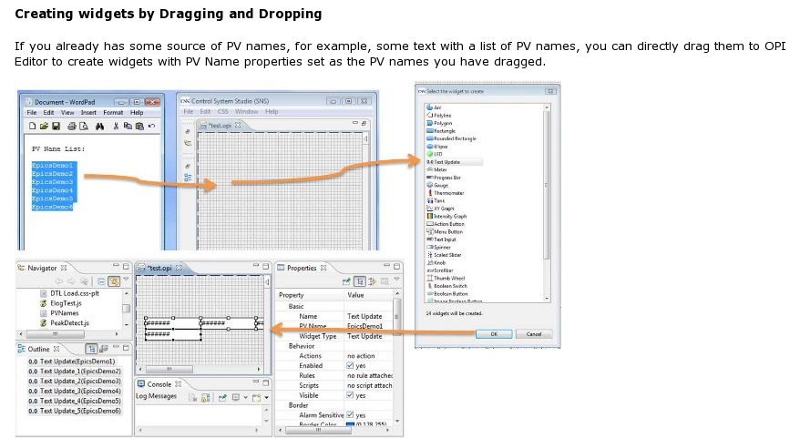
Demo: OPI Editing Skills
Add widgets by dragging text to editor

Slide 23
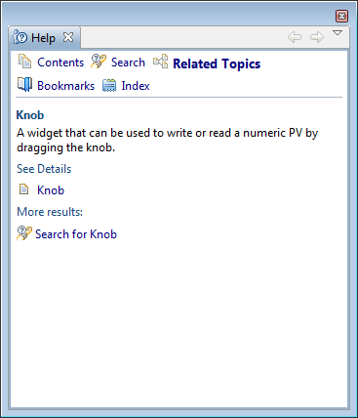
Exercise: Context Help
In OPI editor, press “F1” to open the Help View (or from menu Window->Show View->Help)
Right click the view tab header and select “Detached” to detach it.
Help content will automatically update along with the selected widget
Help view can be detached

Slide 24
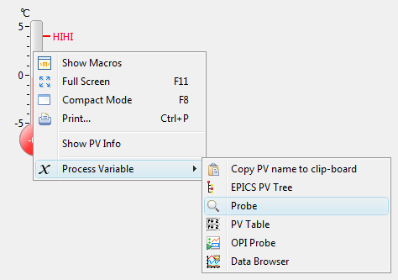
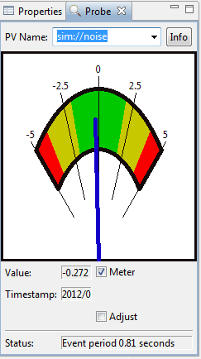
Exercise: send PV name to other CSS tools
Right click a PV widget, select Process Variable->Probe

Slide 25
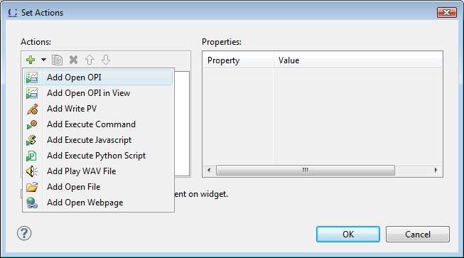
Actions
Every widget can have actions
Click on widget to execute the action
Actions will also appear on widget’s context menu during runtime
Can also be executed from script
widget.executeAction(index);

Slide 26
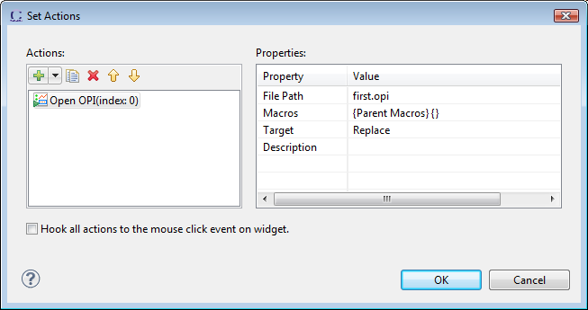
Exercise: Open OPI Action
Create a new OPI named action.opi
Add an Action Button widget
Click on Actions property
Add an Open OPI action, set File Path to first.opi
Run

Slide 27
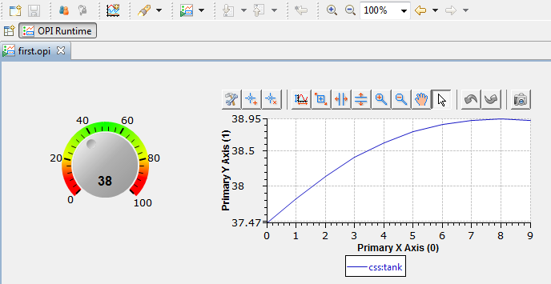
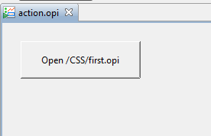
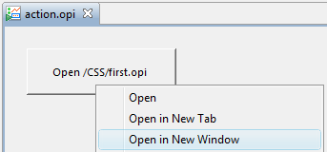
Exercise: OPI navigation
Zoom in/out
Go Back/Forward
Similar to hyperlinks in a Web Browser
Open in new tab by Ctrl+click
Open in new Window by Shift+click
Or use context menu

Slide 28
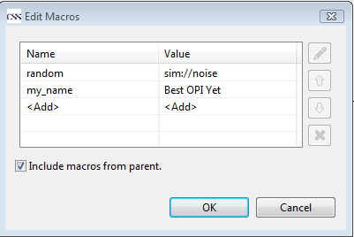
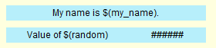
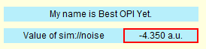
Macro
Embedded in string based properties, such as PV Name, Tooltip
Replaced by its value at runtime
Format: $(macro_name) or $ {macro_name}
All properties can be accessed via macro: $(name), $(pv_name), $(height)
In Editor
In Runtime

Slide 29
Where to define Macros
BOY Runtime Preferences
Open OPI Actions
It includes open OPI from actions, open OPI from command line and open OPI from top OPIs button.
Macros property of Display
Macros property of container widgets
such as Grouping Container, Linking Container and Tabbed Container.
-
Override
Order
+

Slide 30
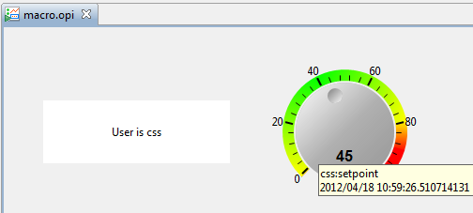
Exercise: Macro
Create macro.opi
Add a label widget, set text to “User is $(user)”
Add a Knob widget, set PV Name to $(user):setpoint
Save (Ctrl+S)
Add an action button in action.opi
Add an Open OPI action
File Path: macro.opi
Macros: user=css
Run

Slide 31
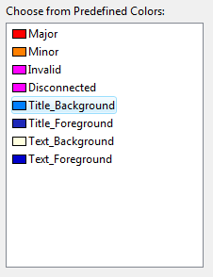
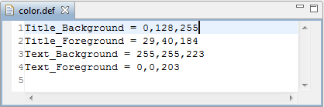
Color & Font Name - make consistent look to your OPIs
Predefined name for colors or fonts in text files
Using predefined color and font name will help you
Achieve consistent look
Reuse some particular color or fonts
Input once and change everywhere

Slide 32
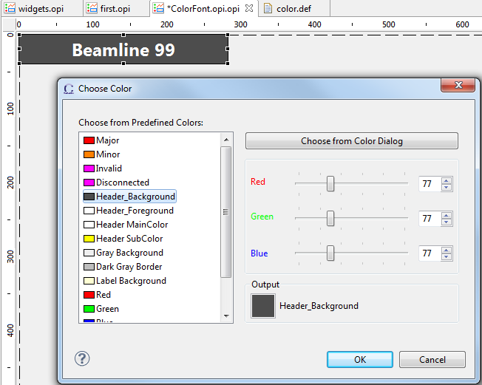
Exercise: Use Color & Font Name
Add a label widget to editor, set:
Background Color : Header_Background
Foreground Color: Header_Foreground
Font: Header1

Slide 33
BOY Advanced

Slide 34
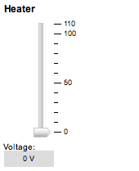
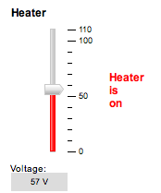
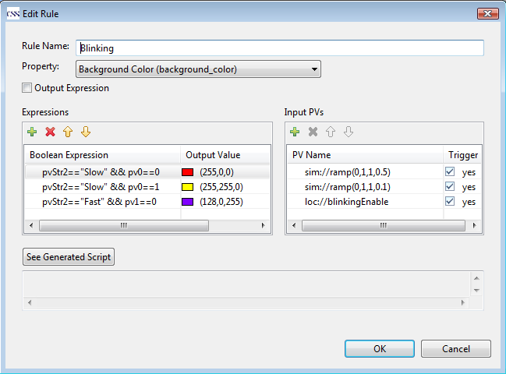
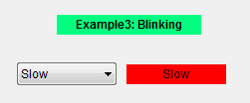
Rules - Easily make widget properties dynamic
Condition depended property value
Directly output PV value to a property
Allows multiple rules on a widget

Slide 35
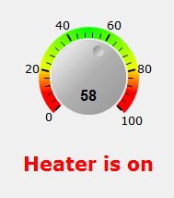
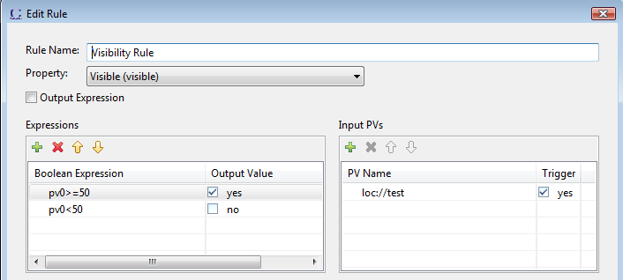
Exercise: Rules
Create a new OPI rules.opi
Add a Knob with PV Name loc://test
Add a Label
Text: “Heater is on”
Foreground color: Red
Click on Rules property and add a rule as below

Slide 36
Scripts - Intelligentize your OPI
For more complex logic that Rules cannot achieved
Support both JavaScript and Python(Jython) Script
Triggered by PV value change or executed from actions
Can do “anything”
access widgets and PVs
attach data to widget
call Java code
Call your custom Java library
Option: Embedding script text in OPI or using a separate script file

Slide 37
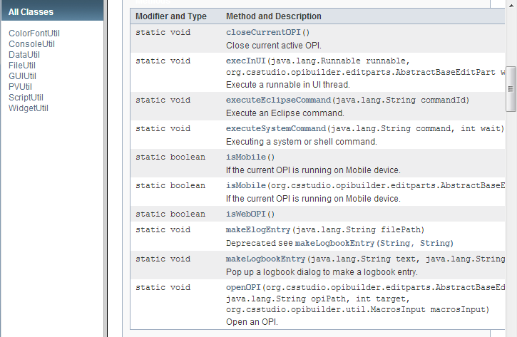
ScriptUtil
Generally useful functions
BOY Online help->Script or http://htmlpreview.github.com/?https://raw.github.com/ControlSystemStudio/cs-studio/master/applications/plugins/org.csstudio.opibuilder/html/script/ScriptUtil/index.html
You can create your own custom ScriptUtil

Slide 38
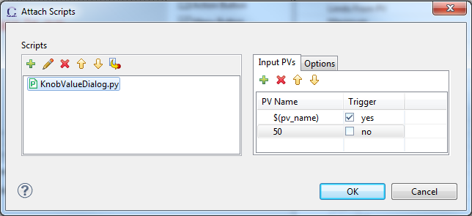
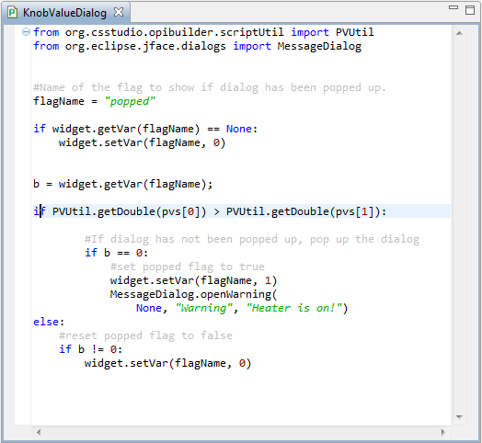
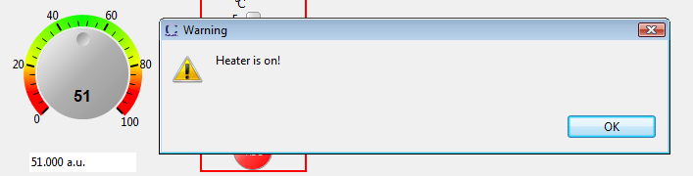
Demo: Scripts
Access Widget
Access PV
Call Java code

Slide 39
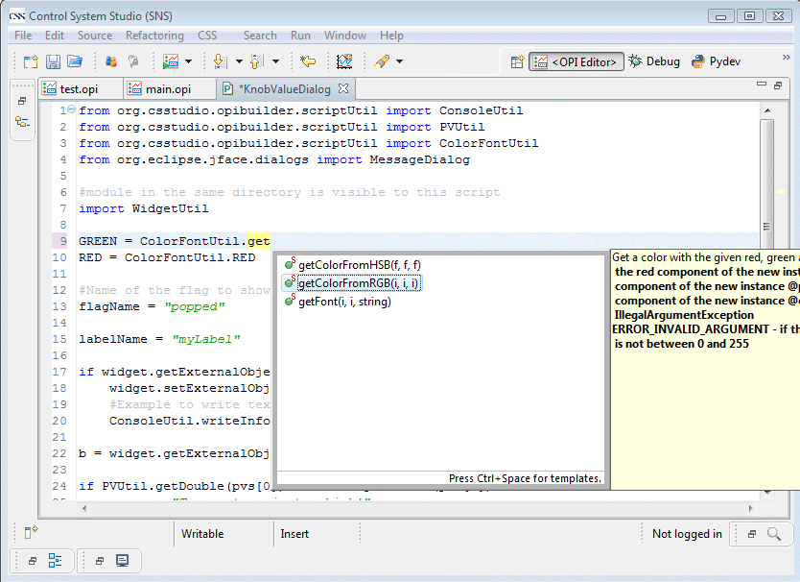
PyDev for python script editing
Syntax highlight, code auto-completion, error check
See BOY Help->Script->Python Script for installation instruction

Slide 40



How powerful a script can be?
Submit a table scan and monitor scan progress.
General GUI applications
/BOY Examples/Miscellaneous/CalculatorExample/Calculator.opi
/BOY Examples/Miscellaneous/Timer.opi

Slide 41



Exercise: Script
Add a label widget with name myLabel
Create a new python script myScript.py
Add a button to widget and add “Execute Python Script” in Actions property as the dialog on right
Run

Slide 42





Widgets
Support various type of data
Double, Integer, String, Enum, Boolean, Waveform…
Allow plugging in customized widgets to BOY

Slide 43

Exercise: Enum widgets
Add Controls/Choice button
PV Name: css:sensor
Items From PV: Yes
Add Controls/Combo Box
PV Name: css:sensor
Items From PV: Yes
Add Monitors/LED
PV Name: css:sensor
Off Color: green
On Color: red
record(bi, "$(user):sensor")
{
field(DESC, "Sensor Simulation")
field(ZNAM, "OK")
field(ONAM, "Broken")
field(OSV, "MAJOR")
field(PINI, "YES")
field(FLNK, "$(user):tank")
}
Similar for bo, mbbi, mbbo records
Notes:
Ignorable

Slide 44

Demo: Linking Container and Macro
Create a new OPI: embedded.opi
Add a label widget with text PV Name: $(pv)
Add an XY Graph widget
PV Name: $(pv)
Save

Slide 45

Demo: Linking Container and Macro (cont’d)
Create a new OPI: linkingContainer.opi
Add an Others/Linking Container widget
Macros: pv=sim://noise
OPI File: embedded.opi
Duplicate extra two linking container widget
Set Macros to pv=sim://sine and pv=sim://ramp repectively
Run

Slide 46

Exercise: XY Graph Widget
Open first.opi in editor
Select XY Graph widget and set:
Trace Count: 2
Primary X Axis (0)
Time Format: Auto
Trace 1
Y PV: css:setpoint
Point style: Point
By default:
It only updates on value change
New value is appended in a buffer

Slide 47

Exercise: XY Graph Widget Cont.
Update trace periodically even there is no value change
Select XY Graph widget
Set properties:
Trigger PV: sim://ramp(0,1,1,1)
Trace 0 and Trace 1:
Update Mode: Trigger

Slide 48

Exercise: XY Graph Widget
Plot Waveform
Add Monitors/XY Graph widget
Trace Count: 2
Trace 0
Buffer Size: 200
Concatenate Data: no
Y PV: css:sineWave
Trace 1
Buffer Size: 200
Concatenate Data: no
Y PV: css:cosWave
Try toolbar buttons to zoom in/out

Slide 49


Widget – Intensity Graph
Display image-like data
Can be used for video display
Generate Profile data
Supports Region of Interest (ROI)
Zoom In/Out

Slide 50


Exercise: Intensity Graph Widget
Add Monitors/Intensity Graph widget
PV Name: css:imageWaveform
Data Height: 200
Data Width: 200
Maximum: 100
Minimum: 100
Some properties can be changed at Runtime:
Right click widget, select Configure Runtime Properties…
Set Color Map to Gray Scale

Slide 51
Golden rules
Simple things are simple
Add widget
Enter PV Name
Run
Use Rules or Scripts only if very necessary
Too many rules or scripts may hurt maintainability

Slide 52



Tip
Display Property: Auto Zoom To Fit All vs Auto Scale Widgets
Zoom whole opi as a picture, including font size. Good for graphics rich OPI.
Auto Zoom To Fit All
Auto Scale Widgets
Elastically scale widgets’ size based on “Scale Options” property of widgets. Font size keeps unchanged.

Slide 53


Learn by yourself
Install BOY Examples
Menu CSS, Display, Install OPI Examples
Double click BOY Examples/main.opi (or right click it and select Open With > OPI Runtime).
Read The Friendly Manual

Slide 54



Examples Showtime
Heater
BOY Examples\Heater\heater.opi
Virtual Linac
BOY Examples\Miscellaneous\Virtual Linac\Virtual_Linac.opi
Widgets
Use Thread
BOY Examples\5_6_UseThreadInScript.opi
Dynamically Loading Widgets
BOY Examples\Miscellaneous\DynamicLoadWidgets\LoadWidgetsExample.opi

Slide 55


WebOPI
BOY OPI in Chrome and iPod Touch

Slide 56


SNS control room screens in Web Browser

Slide 57








Compatible With…
Safari 3+
Chrome 3+
Firefox 2+
IE 6+
Opera 9+
Mobile devices
iPhone, iPod, iPad
Andriod Phone (Opera 9+ or Firefox 2+ browser is required)
Maybe more…
No Flash
No Java Applets
No browser add-on/plugin

Slide 58

3 steps to setup
Step 1. Copy webopi.war to Tomcat webapps/
Step 2. Configure css_rap.ini
Step 3. Copy opi files to opi_repository
org.csstudio.opibuilder/opi_repository=C:/path/BOY Examples/ org.csstudio.opibuilder/startup_opi=main.opi org.csstudio.opibuilder/mobile_startup_opi=mobile.opi org.csstudio.opibuilder/color_file=color.def org.csstudio.opibuilder/font_file=font.def

Slide 59
Try it yourself
Desktop:
http://ics-web.sns.ornl.gov/webopi
Mobile:
http://ics-web.sns.ornl.gov/webopi/ms

Slide 60
Summary
BOY is a set of plugins built on Eclipse
CSS integration
Modern Graphical Editor
Simple things are simple
Dynamic via rules or scripts (JavaScript or Python script)
Modern web browser style Runtime (Tab, CTRL, SHIFT click)
Comprehensive types of widgets and extensible
Sitewide deployment friendly (macro, color, font, schema, http)
BOY OPI is instantly visible on web via WebOPI

Slide 61
Thank you!
BOY Home Page
http://sourceforge.net/apps/trac/cs-studio/wiki/BOY
Or Google “CSS BOY”
What’s new
http://htmlpreview.github.com/?https://github.com/ControlSystemStudio/cs-studio/blob/master/applications/plugins/org.csstudio.opibuilder/html/ChangeLog.html

